Slide 1

Web Development with .NET Lecture 2: ASP.NET State Management, C# and ASP.NET Futures 1 February 2010
MET CS 651 - Chelmsford

Slide 2
Agenda
Part I: Client-side, Server-side, and the Postback model
Part II: Classical State Management Techniques in ASP.NET
Part III: Other State Management Techniques in ASP.NET
Part IV: State Management Futures with .NET 4.0
Part V: Asynchronous ASP.NET
Part VI: From C, C++, and Java to C# 3.0
Part VII: Futures - C# 4.0
Part VIII: .NET Futures

Slide 3
Recap & MORE
Part I: Client-side, Server-side, and the Postback model

Slide 4
Client-side/Server-side
Website1, Website1b
Javascript:alert()
Using <div>, with and without runat=“server”

Slide 5

The Callback

Slide 6
The Postback
In the context of web development, a Postback is another name for HTTP POST
In an interactive webpage, the contents of a form are sent to the server for processing some information
Afterwards, the server sends a new page back to the browser
This is done to verify passwords for logging in, process an on-line order form, or other such tasks that require communication with a server
This is not to be confused with refresh or back actions taken by the buttons on the browser, which may or may not access locally cached information

Slide 7
Postbacks in ASP.NET
Every ASP.NET page is a separate entity with the ability to process its own posted data
ASP.NET Controls run on the server and post back to the same page
Implemented with the use javascript on the client side
Remember the days of classic ASP?
We would create a form which would accept the user's input
Then we would most probably have to create another page that would accept all those inputs, either through HTTP GET or POST, and perform some kind of validation, display, and action
This wasted a lot of time and complicated things when you had to make a change
In ASP.NETm there is no need to create second pages that accept the inputs of the first, process them and so on
Form fields and other controls are declared to run on the server, and the server simply posts the page back to itself and performs all the validation, display and actions

Slide 8
How Postback works in ASP.NET
When a control is declared to run on the server, a VIEWSTATE is created which remembers the ID of that control, and the method to call when an action is performed
We can easily create web applications to use this feature. Let's go through an example..
Website2d
We declare only one web control, a linkbutton, to run on the server, with an ID of Test and we assign a method called Test_Click to run when the link is clicked on the page. The linkbutton has to be wrapped inside a form that runs on the server as well
Click on ‘View Source’ on the Web page to read the HTML & javascript that gets downloaded..

Slide 9
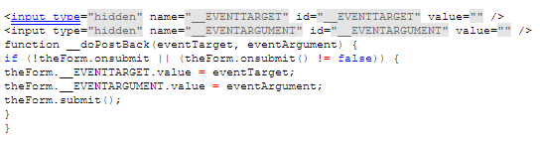

__doPostBack()
eventTarget contains the ID of the control that causes the postback and the eventArgument contains any additional data associated with the control
The value of the eventTarget and eventArgument are stored in the hidden fields
The two hidden variables can be accessed from the code behind using the forms/params collection

Slide 10
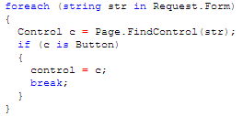
Who generated the PostBack?
Button control (and imagebutton too) does not call the __doPostBack function
Because of this, the _EVENTTARGET will always be empty
If _EVENTTARGET is empty, need to loop through controls to find the button..

Slide 11
More…
At least one control needs to be set to Visible, for the server to generate the __doPostBack function in our page
Even if we have numerous web controls declared to run on the server, but they are all set to Visible=false, then the javascript function will not be included and we will not be able to perform any actions
Setting AutoPostBack to True..
It is possible to cross-page post in ASP.NET..

Slide 12
Cross Page Posting
Cross page posting or cross page postback is used to submit a form on one page (say default.aspx) and retrieve values of controls of this page on another page (say Default2.aspx)
Website1c, Website 1d

Slide 13
ASP.NET
Part II: Classical State Management Techniques in

Slide 14
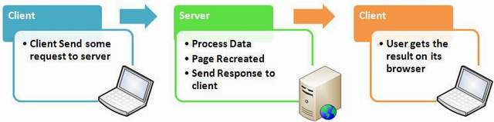
Why State Management?
The Web is Stateless
A new instance of the web page class is re-created each time the page is posted to the server
If we enter a text and client on submit button, text does not appear after post back , only because of page is recreated on its round trip
It’s a big issue to maintain the state of the page and information for a web application
That is the reason for State Management
To overcome this problem ASP.NET provides features like View State, Cookies, Session, and Application objects

Slide 15
Two different types of State Management
Client Side State Management
View State
Hidden Field
Cookies
Control State
Server Side State Management
Session
Application Object
Caching
Database
Client Side state management does not use any server resource , it stores information using client side option
Server Side state management use server side resources to store data
Selecting client side and server side state management should be based on your project requirements

Slide 16
View State
View State is one of the most important and useful client side state management mechanism
The state of the controls is encoded and sent to the server at every form submission in a hidden field known as __VIEWSTATE
The main use for this is to preserve form information across postbacks
Developers need to be wary of storing sensitive or private information in the View state of a page or control, as the base64 string containing the View state data can easily be de-serialized, either by one of many tools available on the web, or any generic base64 decoder
By default, View state does not encrypt the __VIEWSTATE value

Slide 17
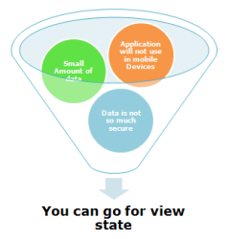
Advantages and disadvantages of View State
Advantages:
Easy to implement
No server resources are required
Enhanced security features (it can be encoded and compressed)
We can store an object as easily as we can store a string or an integer variable
Disadvantages
It can be performance overhead when there are many controls on a Web page
It’s stored in a hidden filed in hashed format and can be easily hacked (the encrypted string is Base64 Encoded, so it can easily be decoded)
It does not have any support on mobile devices

Slide 18
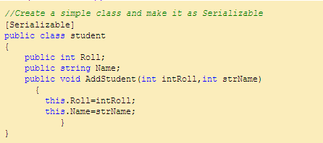
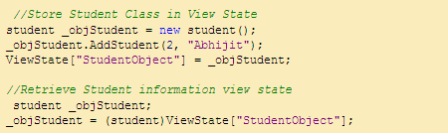
Storing an Object in View State

Slide 19
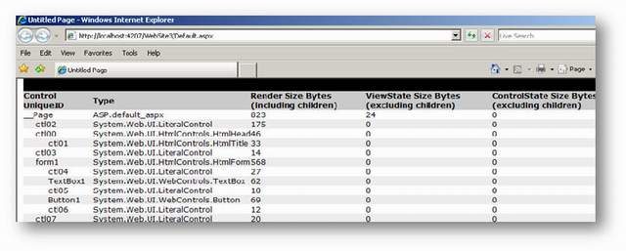
Tracing View State
If you want to trace your view state information, by just enable "Trace" option of Page Directive
Now Run your web application, You can view the details of View State Size along with control ID in Control Tree Section. Don't worry about "Render Size Byte" , this only the size of rendered control

Slide 20
Enabling and Disabling View State
You can enable and disable View state for a single control as well as at page level also. To turnoff view state for a single control , set EnableViewState Property of that control to false. e.g.:
TextBox1.EnableViewState =false; To turnoff the view state of entire page, we need to set EnableViewState to false of Page Directive as shown below
Even you disable view state for the entire page , you will see the hidden view state tag with a small amount of information, ASP.NET always store the controls hierarchy for the page at minimum , even if view state is disabled

Slide 21
Hands-on
Website2, Website 2e

Slide 22
View State and Control State
And you thought you knew everything about View State…
Read “View State and Control State” document
Website2e

Slide 23
ASP.NET
Part III: Other State Management Techniques in

Slide 24
Query String
This is the most simple and efficient way of maintaining information across requests. The information you want to maintain will be sent along with the URL. A typical URL with a query string looks like
The URL part which comes after the ? symbol is called a QueryString
QueryString has two parts, a key and a value
In the above example, query is the key and foo is its value
You can send multiple values through Query String, separated by the & symbol

Slide 25
Cookies
A cookie is a small file which is stored in the visitor's hard disk drive
This is helpful for storing small and trivial information
According to W3C, a cookie can have a maximum size of 4KB
The web server creates a cookie, attaches an additional HTTP header to the response, and sends it to the browser
The browser will then create this cookie in a visitor's computer and includes this cookie for all further requests made to the same domain
Servers can read the cookie value from the request and retain the state

Slide 26

Session State
A cookie is very simple and is not suitable for sophisticated storage requirements
Session state is a workaround for this problem and it gives a method to keep more complex objects securely
ASP.NET allows programmers to keep any type of objects in session
Data stored in session will be kept in server memory and it is protected as it will never get transmitted to a client
Every client that uses the application will have separate sessions
Session state is ideal for storing user specific information

Slide 27
How Session State works
ASP.NET maintains a unique id which is called as "session id" for each session
This id is generated using a custom algorithm and it is unique always
Session id will be sent to the client as a cookie and the browser resends this upon each request. ASP.NET uses this session id to identify the session object
If you haven't stored anything in the session, ASP.NET will generate a different session id for each request
Once a session has contents, the session id will not change
Session id is the only information which is sent to the client about sessions
ASP.NET sends session id in a cookie named ASP.NET_SessionId, unless cookies are disabled by the visitor (in such cases, ASP.NET passes session id through the URL)

Slide 28
Session timeout
Each session will have a timeout value (default 20Mins)
If the page is not getting any requests within the timeout limit specified, ASP.NET will assume that the user has left the application and it immediately terminates the session and fires the End event
This helps the server to cleanup unused sessions and gives room for new requests. Timeout value can be changed from web.config file or through code

Slide 29
Where is Session stored?
The default session storage is for Session to be kept in server memory
<sessionState mode="InProc" />
StateServer mode provides a basic level of isolation for the data storage. It runs as a separate windows service and keeps the session data out of ASP.NET process memory area
<sessionState mode="StateServer" stateConnectionString= "tcpip=Yourservername:42424" />
If you still need more resillient storage, SQLServer mode allows yout to keep session data in SQLServer. This is helpful when your web application is hosted in a webfarm
<sessionState mode="SQLServer" sqlConnectionString="..." />

Slide 30

Application State
ASP.NET implements application state using the System.Web.HttpApplicationState class
It provides methods for storing information which can be accessed globally
Information stored on application state will be available for all the users using the website
Usage of application state is the same as sessions. The following code shows storing a value in an application variable and reading from it

Slide 31
Keeping State in static (C#) or shared (VB) variables
Static variables will have a lifetime until the application domain where it is hosted ends. ASP.NET hosts each website in a separate application domain to provide isolation with other websites hosted on the same server.
Consider a page where all product details are displayed
Product details are fetched from the database and filled into custom collection and returned back to the page
To avoid fetching product details all time for each visitors, we can load it when it is requested for the first time and keep it in a static variable to serve for the next requests

Slide 32
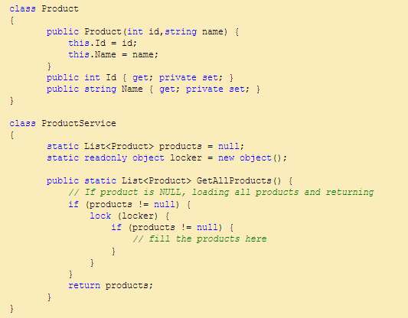
Example
The variable products will have a lifetime until the application domain unloads. When ProductService.GetAllProducts() is called for the first time, it fills the collection and return. For the further requests, it will just return the collection which is already filled
Values kept in static variables are accessible to all visitors in the website. So you should take extra care when writing these methods. Consider locking because multiple visitors may call the GetAllProducts() method at the same time!

Slide 33
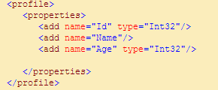
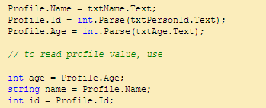
Profiles
Session data is lost when the visitor leaves the webpage. What if you need to persist all the user information for a long time? ASP.NET Profile is the answer. It provides a neat way to persist information for a long time. Creating a profile is trivial. You only need a few entries in the web.config file as seen below ASP.NET generates a strongly typed class for accessing profile data. Data type for the properties are chosen depending upon the type value. Default type is string if no type is specified

Slide 34
Where are Profiles kept?
ASP.NET keeps the profile data in SQLServer database
If no databases are available in the project, it creates a database file in the app_data directory when it is used for the first time
Profiles are implemented using the provider pattern. SQLProfileProvider is the default profile provider
Profiles use windows authentication by default. Profile object can be used with any authentication modes supported by ASP.NET.
Profile is very handy in many situations. However, it has the following drawbacks
It allows to keep only serializable types
Reading data from profile requires database access which can potentially make your application less performant. If your website uses profiles heavily, you have to cache the results to avoid unnecessary database calls

Slide 35
State Management Techniques Demo
Website 3

Slide 36
.NET 4.0
Part IV: State Management Futures with

Slide 37
More Control over View State
View State reduces page bandwidth
You can turn View State on and off using the EnableViewState Page property
Controls on that page inherit that setting by default, but can also independently turn their View State on and off
Only few ASP.NET controls need View State
For example, text boxes use Control State for default Text/Value

Slide 38
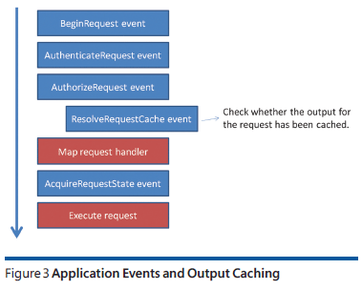
More Control over Output Caching
Many situations where it is acceptable for a page response to be a little stale if this brings significant performance advantages
E.g. product pages tend to remain the same for weeks. Why do a new database query every time a web surfer browses to the catalog of IKEA beds?
Since ASP>NET 1.0, output caching allows you to cache page responses so that follow-up requests can be satisfied from the output cache
Up until now page output is stored in memory in a private area of the ASP.NETcache
In ASP.NET 4.0, the output caching subsystem supports the provider model so that pages can be saved outside of the ASP.NET worker process

Slide 39
Events and timers
Part V: Asynchronous ASP.NET

Slide 40
Hands-on Labs
Website4, Website4b, Website4c

Slide 41
C# (3.0), the language
Part VI: From C, C++, and Java to…

Slide 42
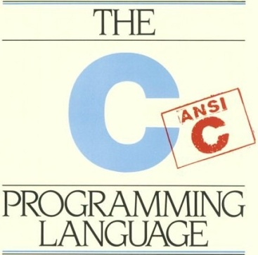
C
Intimate with hardware, therefore very fast language
Primarily used primitive types for working with data
You handle all memory allocation and deallocation
#include <stdio.h>
void main(void)
{
printf("Hello world!");
}
Image: Kernigan, Ritchie et al, C Programming Language

Slide 43
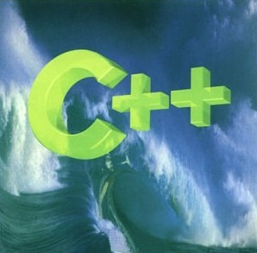
C++
Superset of C
Introduction of objects and object-oriented programming to C
Inheritance, etc.
A very powerful language
the power comes at a cost of complexity
class Greeter {
public:
virtual void ExtendGreeting() = 0;
};
class EnglishGreeter : public Greeter {
public:
void ExtendGreeting() {
printf("Hello!");
}
};
class FrenchGreeter : public Greeter {
public:
void ExtendGreeting() {
printf("Bonjour!");
}
};
int _tmain(int argc, _TCHAR* argv[]) {
Greeter *myGreeter = new FrenchGreeter();
myGreeter->ExtendGreeting();
delete myGreeter;
return 0;
}
Image: Stroustrup, The C++ Programming Language

Slide 44

Java
Purely object-oriented
Handles all memory deallocation – “garbage collection”
“Elimination” of pointers
Polished set of libraries (API) available on all platforms
public interface Greeter {
public void extendGreeting();
}
public class EnglishGreeter implements Greeter {
public void extendGreeting() {
System.out.println("Hello!");
}
}
public class GraciousApplication {
public static void main(String[] args) {
new EnglishGreeter().extendGreeting();
}
}

Slide 45
Java
Garbage collection and cross-platform made possible by the Java Virtual Machine (JVM)
Compiles to interpreted bytecode instead of machine instructions
Multiple benefits:
Cross-platform
Garbage collection
Downsides:
Abstraction between you and hardware, therefore less deep control
A little slower, but “Just-In-Time” (JIT) compiling helps
Your Java app
JVM (Virtual Machine)
Operating System

Slide 46
C#
A hybrid language incorporating features from C++ and Java (and Smalltalk, and…)
Looks a lot like Java, with keywords from C/C++
Object oriented
Has a virtual machine, and garbage collection, among other Java parallels
Your C# app
.NET Framework Class Libraries
CLR (Common Language Runtime)
Operating System

Slide 47
C#
C# is designed as the “exemplar” language for .NET
Primary designer: Anders Hejlsberg
of Borland Pascal and Delphi fame
now probably the most influential architect of .NET
C# is intended to be a simple, modern, general-purpose, object-oriented programming language.
Support for software engineering principles such as strong type checking, array bounds checking, detection of attempts to use uninitialized variables, and automatic garbage collection
A Managed Language
Easier to write programs in
Better “security”
Garbage Collection, Type safety plus run-time checks

Slide 48
Intro to C#
You can use blank space, line, and paragraph breaks to format your code
C# is case sensitive
Every code statement must end in a semicolon
A statement could be a single line or span multiple lines of code
Matching braces { … } constitute a code block
ILDASM
Keywords:
public/private/protected/friend
: (inherits and implements)
partial, sealed, abstract, base, interface, virtual, override
Application entry points: Depends…

Slide 49
Demo
Console1: Counting words

Slide 50
Namespaces
A C# namespace is a way to group a collection of classes.
In C#, when using a .NET object, you need to import the ‘namespace’ for that class
namespace Bcit.Lib {
public class MyClass {
int x;
void doStuff(){}
}
}

Slide 51
Namespace nesting
namespace Utils {
namespace Types {
public class Digits {
public enum Numeric {
Zero, One, Two, Three, Four, Five,
Six, Seven, Eight, Nine
}
}
}
}
C# namespace syntax also allows one to nest namespaces .
namespace Utils.Types {
public class Digits {
public enum Numeric {
Zero, One, Two, Three, Four, Five,
Six, Seven, Eight, Nine
}
}
}
Equivalent

Slide 52
Java/C# equivalence
Java | C#
Class | Class
Package Example: java.sql.* | Namespace Example: System.Data
JAR | Assembly (DLL or EXE)

Slide 53
Namespaces in the Framework’s class library
Namespace | Description
System | Contains essential classes and data types (such as int, double, char, etc…). Implicitly referenced by all C# programs.
System.Data | Contains classes that form ADO.NET, used for database access and manipulation
System.Drawing | Contains classes used for drawing and graphics
System.IO | Contains classes for the input and output of data, such as with files.
System.Threading | Contains classes for multithreading, used to run multiple parts of a program simultaneously
System.Windows.Forms | Contains classes used to create graphical user interfaces
System.XML | Contains classes used to process XML data

Slide 54
Constants
To declare constants in C# the const keyword is used for compile time constants while the readonly keyword is used for runtime constants
using System;
public class ConstantTest{
/* Compile time constants */
const int MIN_TEEN = 13; //implicitly a static variable
/* run time constants */
public static readonly uint maxTeen = (uint) DateTime.Now.Ticks;
/* object reference as constant */
readonly Object obj = new Object();
}

Slide 55
Array declarations
Java has two ways in which one can declare an array:
int[] iArray = new int[100];
int iArray[] = new int[100];
Java Code
C# uses only the former array declaration syntax:
int iArray[] = new int[100]; //ERROR: Won't compile
int[] iArray = new int[100];
C# Code

Slide 56
Switch statement
Two major differences between the switch statement in C# versus that in Java:
In C#, switch statements support the use of string literals
Fall-through not allowed in C# unless the label contains no statements
switch(foo){
case "A":
Console.WriteLine("A seen");
break;
case "B":
case "C":
Console.WriteLine("B or C seen");
break;
case "D": // ERROR: Won't compile due to fall-through at case "D"
Console.WriteLine("D seen");
case "E":
Console.WriteLine("E seen");
break;
}
default case is for ‘none of the above’ and is optional.

Slide 57
ASP.NET and HTML comments
You can use the <%-- and --%> delimiters to insert either single or multiline comments in ASP.NET. This type of comment only exists on the server and is never sent to the client
Example: <%-- an ASP.NET comment --%>
You can also use the generic HTML comments <!-- and -->. Note that HTML comments are sent to the browser.

Slide 58
foreach statement
using System;
class EnumerateCollection {
static void Main() {
int iCount = 0;
int[] iNumberList = new int [] {0,1,2,5,7,8,11};
foreach (int iMember in iNumberList) {
if (iMember>5) iCount++;
}
Console.WriteLine("Out of {0} numbers, {1} Numbers are greater than five.",
iNumberList.GetLength(0), iCount) ;
}
}

Slide 59
String.Format
Format Code | Description
C or c | Formats the string as currency. Precedes the number with an appropriate currency symbol ($ in US). Separates digits with an appropriate separator character (comma in US) and sets the number of decimal places to two by default.
D or d | Formats the string as a decimal
N or n | Formats the string with commas and two decimal places
E or e | Formats the number using scientific notation with a default of six decimal places
F or f | Formats the string with a fixed number of decimal places (two by default)
G or g | General. Either E or F
X or x | Formats the string as hexadecimal

Slide 60
Reference and Value types
You should know the difference
An object of a reference type (class) is a handle to an object (holding a value)
Has reference semantics
Copy duplicates (rebinds) the reference
Essentially all (all?) CLR types are reference types
An object of a value type (struct) holds a value
Has value semantics
Copy duplicates the value
The built-in numeric types are value types

Slide 61
Object
The base of every object
Both structs and classes
Every value can be assigned to an object
Boxing
copy the value and let the object be the handle of the copy
Every object can be cast to an appropriate type
Unboxing
copy the value referred to by the object
If you guess wrong “the system”
Throws System.InvalidCastExceptionfor value types
Returns null for reference types
object class can either be written as object or Object. Lower case object is a C# keyword which is replaced with the class name System.Object during compilation

Slide 62
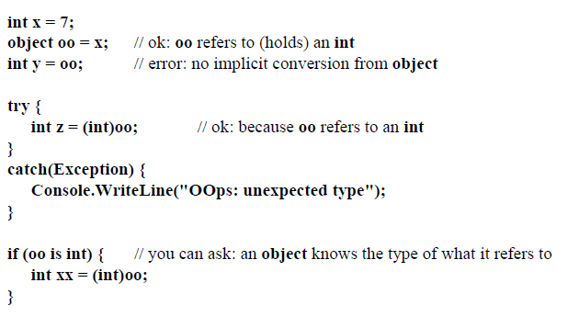
Boxing and unboxing (reference & value types)
Boxing: process of placing a primitive type within an object so that the primitive can be used as an object
C# has no primitive wrapper classes, but allows boxing of any value type, returning a generic Object reference
The boxed object is always a copy of the value object, and is usually immutable
Unboxing the object also returns a copy of the stored value
Repeated boxing and unboxing of objects can have a severe performance impact, since it dynamically allocates new objects and then makes them eligible for Garbage collection

Slide 63
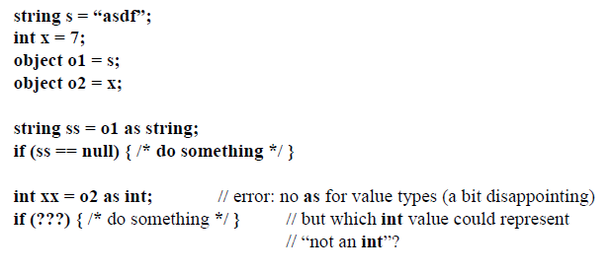
Boxing and unboxing

Slide 64
C# 4.0
Part VII: Futures

Slide 65
Programming Language Trends
Concurrent
Dynamic
Declarative

Slide 66
Declarative
Classic programming involves an imperative programming style where one must write very explicit instructions and detail on how we want something to be done
This can have optimization side effects as the compiler has no choice but to execute step-by-step
Declarative programming is more about stating an idea, but not having overly specific instruction
For example, in LINQ you can use the abstract "order by" or "group by" that specifies what you want to happen, but does not lock the compiler in to having to perform the operations in a specified manner and leaves room for optimization
What
How
Imperative
Declarative

Slide 67
Dynamic
Dynamic languages are those that have a loose coupling between applications and data services
They involve implicit typing, meta programming, and do not involve compilation
The popularity of dynamic languages such as Python, Ruby, and JavaScript can be seen all across the Internet
To date Microsoft .NET has been about static languages that are robust and offer better scaling. While each has its own strengths and weaknesses, ideally you can borrow from both dynamic and static to create something great
Dynamic Languages
Static Languages
Robust
Simple and succinct
Intelligent tools
Implicitly typed
Meta-programming
No compilation
Performant
Better scaling

Slide 68
Concurrent
Concurrent, also known as parallel, programming is about writing code designed to execute multiple steps at the same time
Moore's law has allowed us to largely ignore writing code designed to execute in parallel because the processor speed has continued to increase over time making hardware that is more powerful readily available
However, clock speeds have leveled out now around 2.5 GHz. In order to provide increased performance, engineers have started adding more cores to the processor
With more cores available, it means to get the next level of performance from your applications you would have previously gotten by purchasing a faster processor you will likely need to result to writing code to execute concurrently
Much like multithreading, writing parallel code is hard and there is no magic answer to make it simple

Slide 69
The Evolution of C#
C# 4.0
Dynamic Programming
C# 3.0
Language Integrated Query
C# 2.0
Generics
C# 1.0
Managed Code

Slide 70
Static (compiled) or Dynamic (interpreted)?
The argument for and against dynamic languages and static languages has been around since programming languages were first created
Each paradigm has its strengths and weaknesses
The Common Language Runtime (CLR) is a common platform introduced in Microsoft .NET 1.0 for statically typed objects.
Since the static paradigm was the only paradigm supported, those seeking support for dynamic languages were forced to turn elsewhere.
The Dynamic Language Runtime (DLR) introduced support for dynamic languages on .NET. This creates the possibility of a "best of" scenario where you can use from both paradigms
The type of an object—as well as the members it contains—in dynamic languages can change during a program lifetime
DynamicSite objects represent and cache the state of the object and its methods

Slide 71
More about the DLR
A dynamic type system, to be shared by all languages utilizing the DLR services
Dynamic method dispatch
Dynamic dispatch is the process of mapping a message to a specific sequence of code (method) at runtime. This is done to support the cases where the appropriate method cannot be determined at compile-time (i.e. statically)
Single and multiple dispatch
Dynamic code generation
Self-modifying code: code that alters its own instructions while it is executing
Frequently used by JIT compilers
Most scripting languages such as Perl, Python and javascript are interpreted, which means that the program can easily generate new code dynamically and then execute it 'on-the-fly‘
Also, dynamic dispatch and virtual tables can be considered a form of self-modification using late binding to choose which control flow the program will actually take.
Hosting API

Slide 72
Mixing Static and Dynamic
Calculator calc = GetCalculator();
int sum = calc.Add(10, 20);
object calc = GetCalculator();
Type calcType = calc.GetType();
object res = calcType.InvokeMember("Add",
BindingFlags.InvokeMethod, null,
new object[] { 10, 20 });
int sum = Convert.ToInt32(res);
ScriptObject calc = GetCalculator();
object res = calc.Invoke("Add", 10, 20);
int sum = Convert.ToInt32(res);
Statically typed to be dynamic
dynamic calc = GetCalculator();
int sum = calc.Add(10, 20);
Dynamic conversion
Dynamic method invocation

Slide 73
Dynamically Typed Objects
Compile-time type dynamic
Run-time type System.Int32
dynamic x = 1;
dynamic y = "Hello";
dynamic z = new List<int> { 1, 2, 3 };
When operand(s) are dynamic…
Member selection deferred to run-time
At run-time, actual type(s) substituted for dynamic
Static result type of operation is dynamic
Compare to var: static type resolution

Slide 74
Dynamically Typed Objects
public static class Math
{
public static decimal Abs(decimal value);
public static double Abs(double value);
public static float Abs(float value);
public static int Abs(int value);
public static long Abs(long value);
public static sbyte Abs(sbyte value);
public static short Abs(short value);
...
}
Method chosen at compile-time: double Abs(double x)
double x = 1.75;
double y = Math.Abs(x);
Method chosen at run-time: double Abs(double x)
dynamic x = 1.75;
dynamic y = Math.Abs(x);
Method chosen at run-time: int Abs(int x)
dynamic x = 2;
dynamic y = Math.Abs(x);

Slide 75
Optional and Named Parameters
public StreamReader OpenTextFile(
string path,
Encoding encoding,
bool detectEncoding,
int bufferSize);
Optional parameters
public StreamReader OpenTextFile(
string path,
Encoding encoding = null,
bool detectEncoding = true,
int bufferSize = 1024);
Named argument
OpenTextFile("foo.txt", Encoding.UTF8);
OpenTextFile("foo.txt", Encoding.UTF8, bufferSize: 4096);
Named arguments can appear in any order
Arguments evaluated in order written
Named arguments must be last
OpenTextFile(
bufferSize: 4096,
path: "foo.txt",
detectEncoding: false);
Non-optional must be specified

Slide 76
CLR 4.0
Part VIII: .NET Futures

Slide 77
.NET 4.0
Public Beta released on 20 May 2009
3.5
3.0
.NET 1.0
.NET 1.1
.NET 2.0
.NET 4.0
2002
2003
2005-08
2010

Slide 78
What is the CLR (Review)
WPF
Win Forms
DLR
Dynamic Language Runtime
ASP. NET
WCF
LINQ
And more!
Base Class Libraries
The CLR
Profiling& Debugging APIs
JIT & NGEN
Garbage Collector
Security Model
Exception Handling
Loader & Binder

Slide 79
.NET 4.0 Improvements
Working Better Together
In Process Side X Side
Native/Managed Interop
Dynamic and Functional Languages
Faster
3.5 SP1 improvements
Threading
Garbage Collection
Profiling
With fewer bugs
Corrupted State Exceptions
Debugging
Code Contracts

Slide 80
In-Process side by side Model
Run both 2.0-based and 4.0-based CLR in the same process
Old components use old CLR
New components use new CLR
i
2.0 addin
3.0 addin
3.5 addin
4.0 addin
3.5
.NET 4.0
3.0
.NET 2.0
Host Process (e.g. Outlook)
Configuration file and hosting APIs give you fine grained control
For both applications and COM, a config file describes which versions you run on, and which you prefer

Slide 81
Code Contracts
You know a lot about your code
Some argument to a method is never NULL, other bad inputs
Return value properties
Today, very few ways to tell the computer what you know, have it help look for errors
Assert statements
Some third party tools that can handle some special cases, like “Null”
Cool new bleeding edge stuff

Slide 82
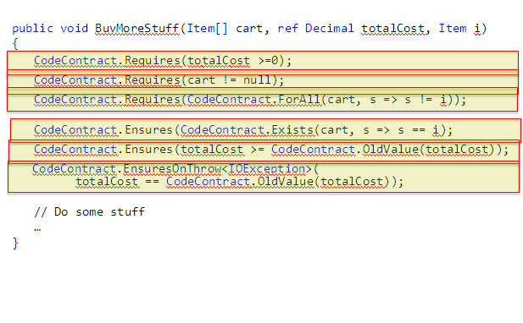
Code Contracts - Example

Slide 83
More goodies
Parallel Extensions to improve support for parallel computing, which target multi-core or distributed systems
PLINQ (Parallel LINQ), a parallel implementation of the LINQ engine, and Task Parallel Library, which exposes parallel constructs via method calls
New Visual Basic and C# language features
Statement lambdas, implicit line continuations, dynamic dispatch, named parameters, and optional parameters
Full support for IronPython, IronRuby, and F#
Inclusion of the Oslo modeling platform, along with the M programming language
Building textual domain-specific languages and software models with XAML
Oslo is the former code name for what is now called the SQL Server Modeling CTP. A set of software development and systems management tools

Slide 84
Oslo: a development process that revolves around building applications primarily through metadata
Costs customers too much to maintain their existing systems and not easy enough for them to build new ones
To reduce ongoing maintenance costs while at the same time simplifying the cost of new application development
End-to-end thinking, from the beginning of the development cycle all the way through to the deployment and maintenance, and all the way throughout the entire application lifecycle
IT department and their development environment are two different silos
Anytime you want to deploy an application or service, the developer builds it, throws it over the wall to IT, they try to deploy it, it breaks a policy or breaks some configuration, they hand that feedback to the developer, and so on. Costly way of doing business
By capturing policies and configuration (app health) in models, one can deploy that in a test environment very easily and very quickly (especially using virtualization)
Move more of the definition of an application out of the world of code and into the world of data, where the developer’s original intent is increasingly transparent to both the platform and other developers

Slide 85
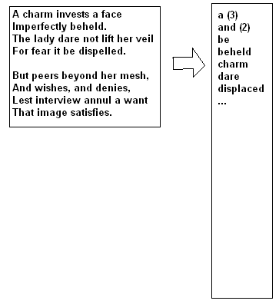
Homework
Go to http://www.csharp-station.com/Tutorial.aspx
Do as many lessons as you want, but especially 2, 3, 4, 5, 6, 14, and 21
Read “.NET Common Language Runtime Hosts” paper
Read “Ten things about Client-Server Control Interactions” paper (both on Blackboard)
Write Web site that reads in lines of text entered by users, separates them into words, sorts them, and prints them out together with their number of occurrences
Extra credit: As the user enters or changes the text, the word list is automatically updated (hint: use events)
Don’t hesitate, send email with questions

Slide 86


